Slide 1

HR Employees Attrition
IBM

Slide 2
Content:
Overview
Attrition meaning
Data Analysis Process
Ask
Prepare
Process
Analyze
Outliers
Recommendations

Slide 3
Overview
This dataset is from IBM to analyze the HR employee attrition and performance. It has 35 features describing each employee’s background and characteristics; and labeled with if they are still in the company or not.

Slide 4
Attrition meaning
Employee attrition refers to the deliberate downsizing of a company's workforce.
Downsizing happens when employees resign or retire.
There are many reasons why employee attrition takes place.
For example:
-Poor work environment
-Poor work-life balance
-Unsatisfactory pay and/or benefits

Slide 5
Data Analysis Process
consists of six phases : 1. Ask: effective questions to define the problem. 2. Prepare: collect and view the information. 3. Process: cleaning and checking the information. 4. Analyze: to find patterns, relationships, and trends. 5. Share: with audience/stakeholders. 6. Act: on the data and use the analysis results

Slide 6
1. Ask: Business Objective
Our goal is to explore and analyze the data to understand how these factors related to employee attrition, in order to prevent valuable employees from leaving.

Slide 7
2. Prepare: Exploring The Dataset
Demographic Factors:
Age, Education, Gender, Marital Status…
Work-related Factors:
Business Travel, Department, Monthly Income…

Slide 8
3. Process: Cleaning The Data
Removed unnecessary columns:
Employee Count, Over 18, Standard Hours.
Changed the wrong data type.
Divided tables to created a “Star Schema”.

Slide 9
4. Analyze :
Found that :
Employees are: 1470
Attrition employees are : 273
Attrition Rate is : 16%

Slide 10
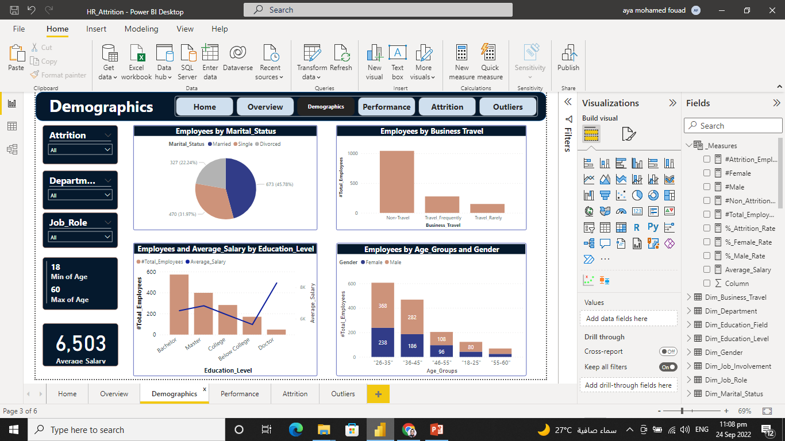
Analyze …
conclusion :
Most employees are married

Slide 11
Analyze …
conclusion :
Most employees work and live in the same place.

Slide 12
Analyze …
conclusion :
Most employees have a bachelor’s degree.
The employee who has a doctor’s degree has the largest salary.

Slide 13

Analyze …
conclusion :
The most popular employee age group is between 26:35.
The Males are larger than the females.

Slide 14
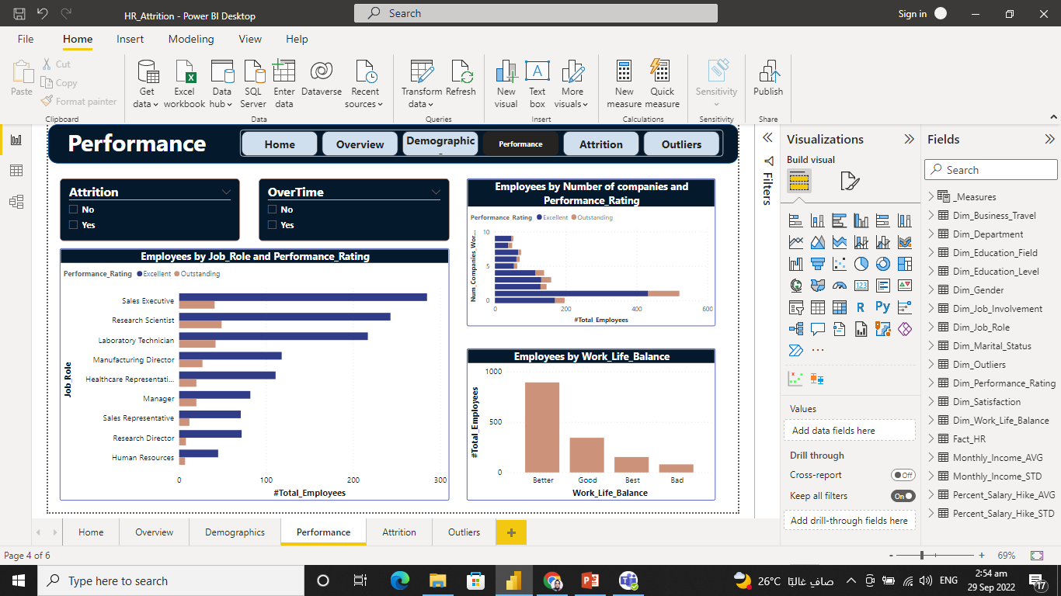
Analyze …
conclusion :
Most Employees have Better work-life balance.

Slide 15

Attrition Analysis

Slide 16
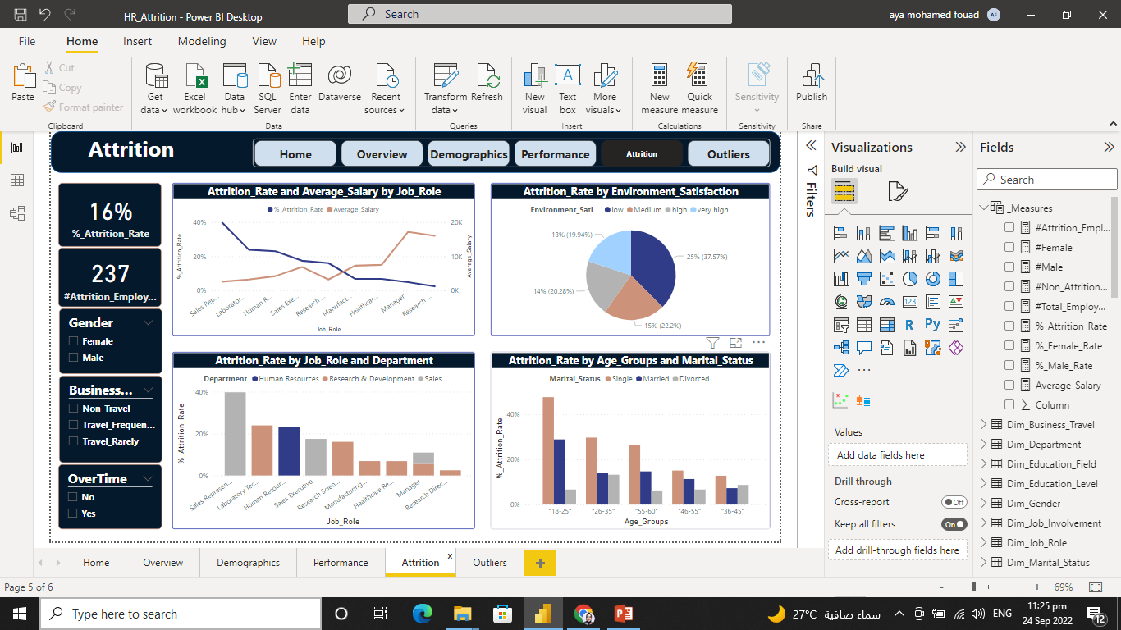
Attrition Analysis…
conclusion :
Employees who have a high salary, have the smallest attrition rate and they work as Research Directors.

Slide 17
Attrition Analysis…
conclusion :
Employees who are in the Sales department, especially in the Sales representative role, have the highest attrition rate.

Slide 18
Attrition Analysis…
conclusion :
Employees who have low environmental satisfaction, have the biggest attrition rate.

Slide 19
Attrition Analysis…
conclusion :
Employees who are at 18:25 group age and whose marital status is single, have the highest attrition rate.

Slide 20
Outliers
An outlier is an observation that lies an abnormal distance from other values.
There are no outliers in:
-Monthly income
-percent salary hike.

Slide 21
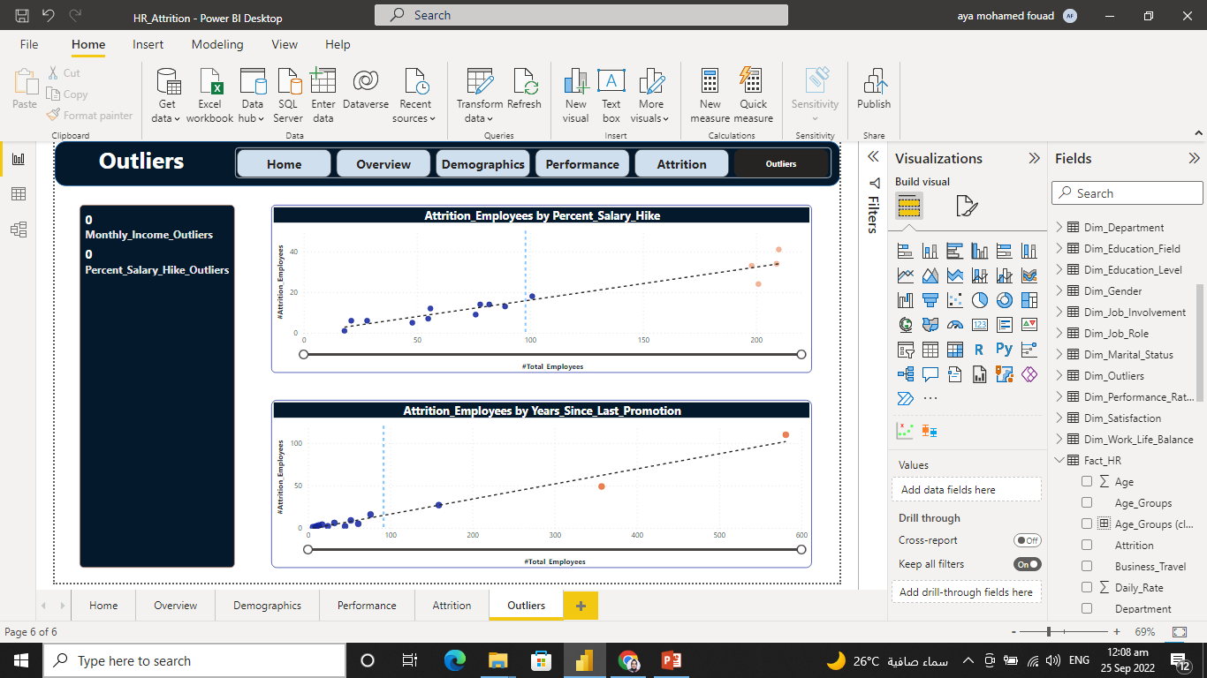
Outliers…
But there are outliers when we group attrition with another factor.
For example:
- percent salary hike.
- years since the last promotion.

Slide 22

Recommendations

Slide 23
Recommendations…
To have a low attrition rate, it is important for a company to:
Fairly pay employees in different job roles, in proportion to the average payment in the job market.
Deeper consideration into the sales department, especially the Sales representative role to understand the causes of attrition and resolve them. For example: increase the payment, and make sure that their working overtime is being paid.

Slide 24
Recommendations…
consider the employees' environmental satisfaction, by discussing the reasons for this low satisfaction with them and resolve them. Frequent and one-to-one communication is strongly recommended.
care about juniors in the team, especially those who are single by increasing the learning curve, activities, and awards.

Slide 25
Thanks
Hopefully, to decrease employee attrition in the future with those recommendations.

